Slide 1
Title Defense
Project Title:
Group Members:
Shulabh Shrestha
Raja Mandal
Aishwarya Prashant
Saistha Pradhan

Slide 2
Objectives
To enable quick and easy pre-ordering of food for students
To provide real-time order tracking
To improve canteen efficiency and reduce waiting time

Slide 3
Scope
Digital menu with categorized items and admin-controlled “Today’s Special”
One click ordering system with confirmation or undo and real-time order status tracking
Admin dashboard to manage orders, mark items as sold out, and update “Paid & Collected”

Slide 4
Feasibility Study
Technical Feasibility: Easily developed using basic web technologies with no complex requirements.
Operational Feasibility: Simple for students and staff to use, improving canteen workflow.
Economic Feasibility: Low-cost system with high efficiency benefits.

Slide 5
Tools and Techniques
Git and GitHub for collaborations
Draw.io for making UML Diagrams
PHP will be our primary programming language(Front&Backend)

Slide 6
Expected Outcome
Students able to place orders instantly.
Real-time order tracking helps staff prepare only what’s needed.
Improved inventory control with “Sold out” system.

Slide 7
Literature Review

Slide 8
Methodology

Slide 9
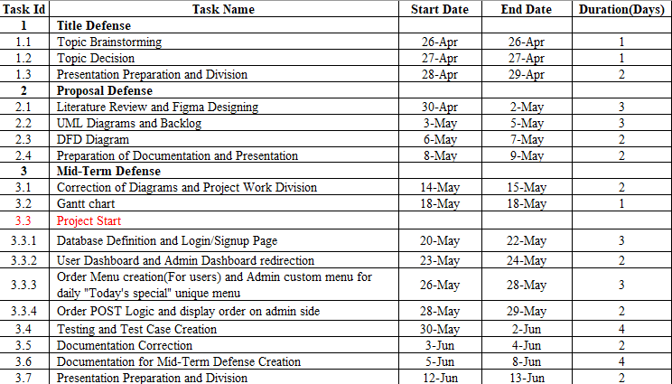
Timeline

Slide 10
Future Enhancements

